Slide 1
Recent developments in long-term care and palliative care in the Netherlands
Fred Lafeber
Department of Long-Term Care
fn.lafeber@minvws.nl

Slide 2
Outline
Long-term care
& palliative care
Trends and challenges
Address challenges 1
Good organisation & finance
Address challenges 2
Offer social protection
Address challenges 3 Additional policy programmes

Slide 3

Kingdom of the Netherlands
Four countries
European and Caribbean
Own responsibility
for health and long-term care
This presentation is on the situation in the European part of the Netherlands
(18 mln inhabitants)

Slide 4

1. Trends
Ageing: more older people, with higher life expectancy
with impact on public health
on care and cure
on need for palliative care

Slide 5
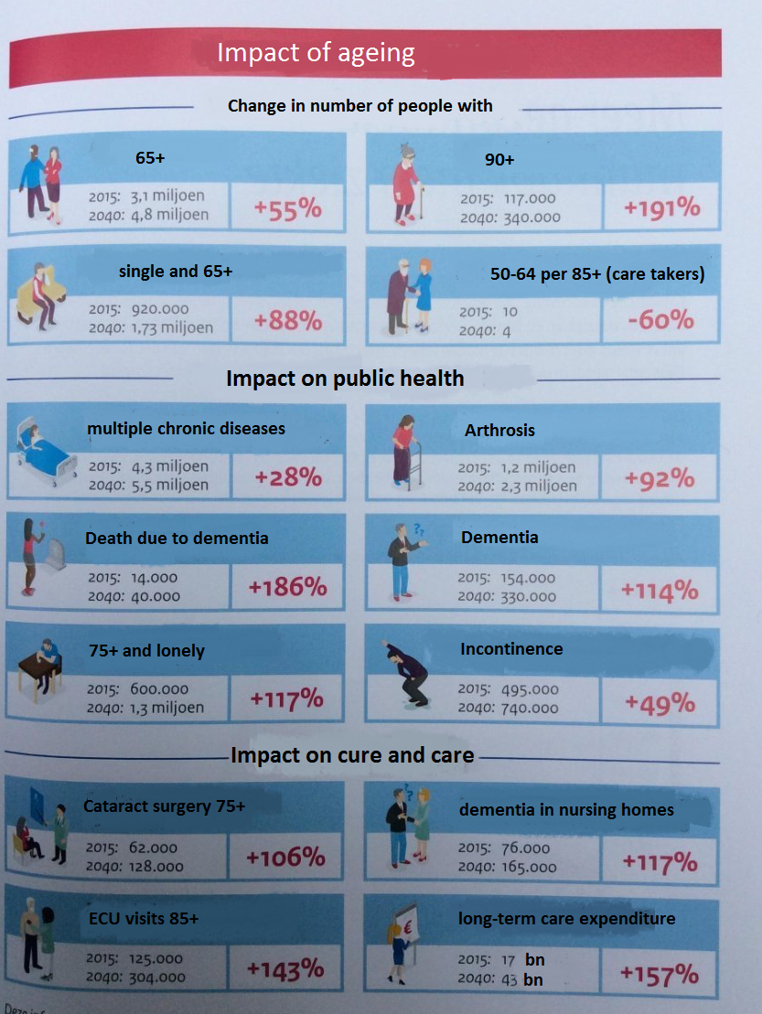

Slide 6

Trends
Ageing (with impact on ….)
Higher expectations of people
(housing, quality of care, treatment options)
More people living alone and/or longer at home
Inequalities in health still widespread

Slide 7
Inequalities and frailty
More frailty among:
- uneducated (36% low education vs 14% high education)
- low income groups (44% low income vs 21% high income)
Source: Frail older people in the Netherlands, The Netherlands Institute for Social Research, 2011

Slide 8

Challenges
Increasing expenditures on long-term care and palliative care
Finding balance between the right to receive care and own responsibility of people.
Pressure on solidarity

Slide 9
More challenges and link with rights of older people
Ensure better accessibility
(right to receive long-term care and palliative care,
with less paperwork and affordable for all)
Better quality of care
(right to complain, focus on personal choice, human touch & quality of life)
Enable fuller participation
(right to function in society)
Notes:
Care costs:
€ 50.000 - € 60.000: institutional care (average 1 person/1 year)
€ 10.000 - € 15.000: home care (average 1 person/1 year)

Slide 10
Addressing the challenges 1
Good organisation of long-term and palliative care
Health Insurance Act (Zvw)
Private healthcare insurance: GP’s / medication / hospitals / district nurse / personal care Includes palliative care at home, in hospices and in hospitals
Long-term Care Act (Wlz)
Public long-term care insurance: nursing homes / care at home / people with disabilities
Includes palliative care in nursing homes and for Wlz–clients living at home
Social Support Act (Wmo)
Participation, support 4 informal carers, shelter --- Municipality responsible
Includes additional support for people receiving palliative care and their informal carers
(respite care, additional support for cleaning etc.)

Slide 11
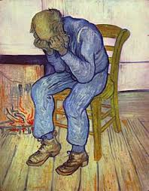
Organisation and financing of palliative care
Integrated in main health laws
Additional financing scheme for palliative care provided by volunteers and majority of hospices
66 networks palliative care
Consultation by specialists where needed

Slide 12
Addressing the challenges 2
Good social protection of long-term care and palliative care in international perspective
Wide differences among countries in scope and type of support. Difficult to compare.
EC/OECD project on long-term care (ADL and iADL)
Netherlands high expenditures on long-term care
Result: offers good social protection against costs of Ltc

Slide 13
LTC system in the Netherlands: international comparison

Slide 14
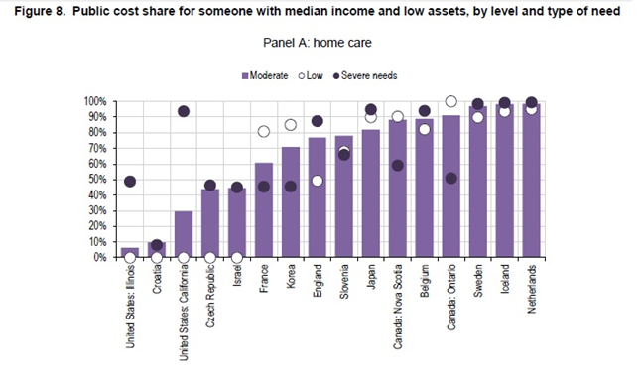
EC/OECD project: Social protection home care

Slide 15
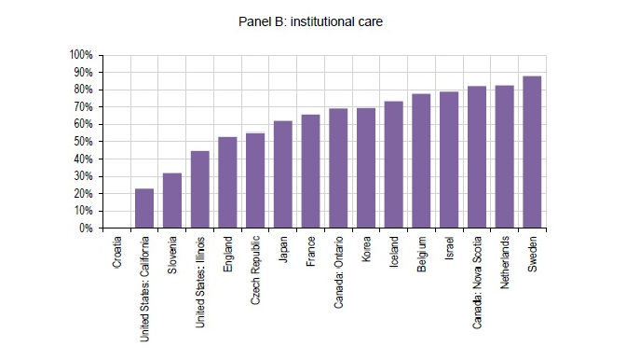
Social protection for costs of nursing home care
Public cost share for someone with median income and low assets

Slide 16
Addressing the challenges 3
Additional policy programmes for older people
Umbrella activities
- Pact for elderly care
- Campaign to revalue old age
- Separate minister for elderly care Hugo de Jonge (also vice PM)
3 main supporting programmes
- Nursing homes: Dignity and pride
- United against loneliness
- Living longer at home
3. Palliative care: National programme palliative care
4. Spiritual care (aimed at lonely older people and people confronted with the end of life, upcoming)

Slide 17
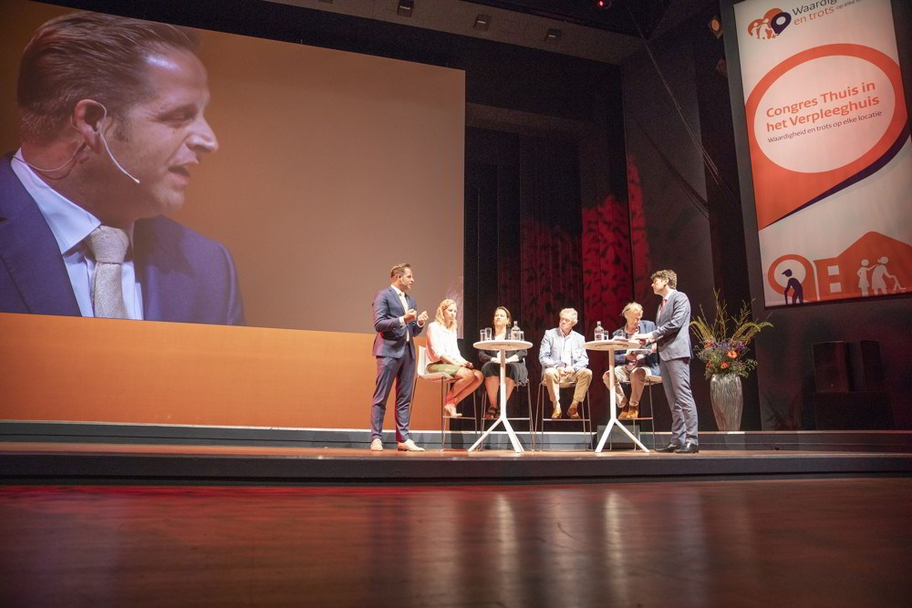
Example of program
Dignity & Pride

Slide 18

With 2000 people present, including many nurses and supporting staff that will have to provide this better care!

Slide 19
Extra: National program palliative care
4 themes and 14 concrete targets:
- Awareness
- Organisation and continuity
- Quality
- Patient involvement (including informal carers)
2. Research programme (8 million, 70+ projects pending)
3. Practice team to address urgent needs (solve and learn)

Slide 20
Conclusions
Many challenges due to ageing and other trends
2. Answer by an elaborated system of long-term care
3. Palliative care is (mostly) not seperated, but integrated in the health and long-term care system
4. In international perspective the system is expensive but offers good social protection against long-term care costs
5. Many additional policy initiatives to address the needs of older people.

